Slide 1



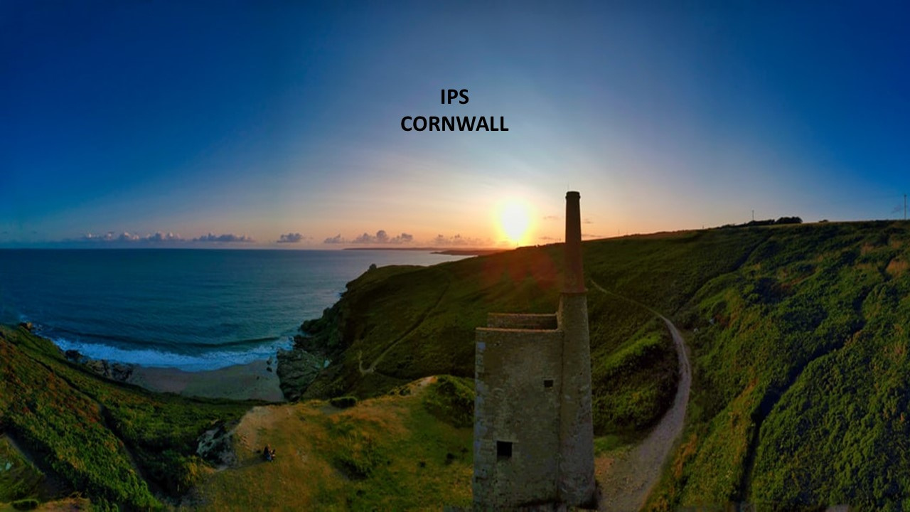

IPS Service
Individual Placement and
Support Employment Stories
www.pentreath.co.uk
March 2025

Slide 2

Content
  Content
  Introduction
  What is IPS?
  Principles of IPS
  IPS Client Reflections
  Clinicians Reflections of IPS Service
01
02
03
04
05
11
01

Slide 3


Introduction
The Individual Placement and Support (IPS) service is a partnership between Pentreath and Cornwall Partnership Foundation Trust, supporting those with severe mental illness to gain and sustain paid employment. Employment Specialists (ES) and Peer Mentors (PM) are based within the Community Mental Health Teams (CMHT), Early Intervention in Psychosis Teams, Community Rehabilitation Mental Health Team and the Forensic Service. We also work with clients referred from the Adult Eating Disorders Service and Complex Emotional Difficulties Service. In addition, we are starting to deliver the IPS service in primary care settings to widen accessibility.
This booklet provides the experiences of some of the individuals who have accessed the IPS service. Told from their own perspective, they share their journey from accessing the IPS service through to what it means for them and their hopes for the future, reflecting how employment can play an important role in someone’s recovery journey by providing integration into society through increased social networks, improved mental health and financial independence.
Sharing the stories of individuals can help to promote the recovery of others and has the potential to change someone’s life. For anyone accessing the IPS service, hearing a story of someone in a similar position can provide hope and inspiration for them.
02

Slide 4


What is IPS?
What do we do?
Individual Placement and Support is a ‘place then train’ evidenced based model of employment support. We work with people referred to us who have expressed a wish to get into paid work. We help them to find the right position for them and then provide support to help them maintain their job. Level of ‘Job readiness’ or diagnosis are not barriers for engagement in the IPS model. We also have the ability to support a small percentage of people to retain employment.
Who are we?
We are a team of Employment Specialists and Peer Mentors based across the Mental Health Services in Cornwall. Many of our members of staff have had lived experience of mental ill health and are able to provide a unique perspective and understand the challenges of looking for a job and gaining employment.
How do we work?
We work closely with the clinical team, the person referred and local employers. A whole time equivalent Employment Specialist has an active caseload of up to 20 people.
03

Slide 5





2
1
3
It is open to all those who want to work – With no exclusions based on diagnosis, health condition or benefits claim.
It aims to get people into competitive employment – Volunteering or sheltered work are not counted as outcomes.
It tries to find jobs consistent with people’s preferences.
IPS Principles
8
4
IPS uses a personalised and strength-based approach to support people to find a job of their choosing following these principles.
Benefits counselling is included – So no one is made worse off by participating.
It works quickly – Job search starts within four weeks, even if a client has been off work for years.
7
5
It provides ongoing, individualised support for the person and their employer – Helping people to keep their jobs at difficult times.
6
It brings employment specialists into clinical teams – So that employment becomes a core part of the mental health treatment pathway and recovery
Employment specialists develop relationships with employers based on a person’s work preferences – Not based on who happens to have jobs.
04

Slide 6

IPS Client Reflections

Slide 7
I have been a Mum of 2 for 29 years and fulltime Carer for my son all this time. I was diagnosed with lung cancer in 2023 and this caused my mental health to deteriorate and I was diagnosed with psychosis and was assessed by the EIT team and taken onto caseload. The team in general have been supportive and encouraged me at first to leave my property, I attended groups run by the team and had CBT therapy, all of which helped me to a point where I could think about returning to work. I have had a variety of jobs from cleaning in a care home and also worked in Retail. I was working closely with my support worker and I felt I was ready to begin thinking about work and creating a life for myself. The support worker let me know they had an Employment Specialist who worked as part of the team and would help me find some paid work and I had met him at one of the groups run by the team. My thoughts about IPS were that I would be supported filling out application forms. I subsequently found out at our first meeting all the other support that was on offer, which included helping with my CV creating a cover letter. Interview Prep, my work preferences talking about disclosure and we went out and spoke to employers together and providing in work support. I was initially nervous and anxious about meeting my ES, but soon he put me at ease, with a nice coffee and we arranged regular meetings to complete lots of paperwork!! My ES introduced me to a Peer Mentor who I instantly built a great relationship with, she helped me identify my work preferences by creating a fantastic mind map. She also supported me with a visit to Shelter in Plymouth due to a housing issue with my son, without her support things could have de-railed and my focus looking for work would have gone.
My ES has continued to support me with applications forms and interview Prep and actually found the job I now do, which I really enjoy. My challenges were holding my job down whilst supporting my son to find his own flat. The benefits of working have been my integration into society, helped with my confidence and self-esteem. My goal would be to increase my hours at work and build on my social skills and look forward to the future with a positive mindset. My life now has more structure, physically I am getting fitter as well as mentally stronger. Less anxiety and more positive about the future.
I have had the luxury of working with my ES who has been incredibly supportive and has been friendly for the duration of our time working together, he has helped me and pushed me to be able to do job interviews and get a job. Very helpful and kind person, very good at his job. Glad to have been working with him during this time.
“
My challenges were holding my job down whilst supporting my son to find his own flat. The benefits of working have been my integration into society, helped with my confidence and self-esteem. My goal would be to increase my hours at work and build on my social skills and look forward to the future with a positive mindset. My life now has more structure, physically I am getting fitter as well as mentally stronger. Less anxiety and more positive about the future.
”
06

Slide 8
“
I often found things very difficult because English is not my first language and following events is hard for me. My ES removed this barrier for me and opened the door for me to understand the processes I was going through
When I first met my Employment Specialist, I was quite shy around him but this quickly changed. Immediately he made it clear as to how IPS can support me and we made arrangements to engage with the redeployment process I was going through straight away. I felt supported through the redeployment process and he made it far less stressful for me and could advocate for me during the process.
I often found things very difficult, because English is not my first language, and following events is hard for me. My ES removed this barrier for me and opened the door for me to understand the processes I was going through as well as sorting things out like my pay issues. I would encourage anyone who struggles with English to get involved with IPS, as language barriers can be hard to negotiate. Especially if you are an NHS worker like myself. He liaised with both, my old work and my new job, to make things as smooth a transition as possible and I thank him for this.
Regular meetings where I could be myself and speak my mind, made me feel calmer and helped me mentally to keep going.
We made small manageable goals in my new job that were sequential so, I didn’t feel overwhelmed/stressed/anxious, which was great after being off sick for nearly a year.
I now feel confident in my new job and can independently manage my life thanks to IPS Service and my Employment Specialist’s help. I have told my friends and family about it and would recommend anyone to engage with support with work and wider mental health support. I also would like to thank the mental health team and the professionals there for their support even when it was just letting me talk through my feelings. If I hadn’t got the help, God knows where I would be now and wouldn’t know what to do with my life.
”
07

Slide 9
“
If someone is offered IPS I would suggest they accept it as it is helpful. IPS has helped me feel more engaged and hopeful for the future.
”
I was under CMHT, having had an episode, to sort my medication. When I started to feel better it was suggested to involve IPS rather than a psychiatric nurse. I was so low, and didn’t have direction or know what I was capable of. Working with an Employment Specialist (ES) I was able to narrow down what I can do. The ES supported me to volunteer in a charity shop which I started to enjoy. We continued looking at what I would like to do and I worked out I would like to be a Teaching Assistant. The ES supported me to a volunteering role within the school. I am hoping to get a part time job as a Teaching Assistant. The ES is supporting this and looking for roles.
I was nervous when I first met the ES but now I feel confident to discuss anything about employment. I didn’t know what to expect at the beginning. He has also supported me with the transition to UC.
If the ES doesn’t know something he will always go away and look into it. The ES suggested using a Peer Mentor (PM) for support. I was happy about that as it is good to talk about things not necessarily related to employment. This included any problems with my mental health or home life. I have found this very beneficial.
Working helps me feel better about myself, financially I will be better off, leads to friendships, gives me meaning and I feel worthwhile.
If someone is offered IPS I would suggest they accept it as it is helpful. IPS has helped me feel more engaged and hopeful for the future.
08

Slide 10
“
IPS thankfully stepped in and have been there to support me and my carer throughout getting and securing a job and keeping it.
”
Following a period of being very unwell, as I recovered, I wanted to get back to working and feel part of a ‘normal’ society again rather than ‘ill society’. Thinking about doing this, job interviews, first day at work, new co-workers was overwhelming and a real red barrier to returning to employment for me. IPS thankfully stepped in and have been there to support me and my carer throughout getting and securing a job and keeping it. I needed the encouragement and belief that I could do this and IPS gave me this in bucketloads. Thankyou!
I love my job; my self-esteem is back to where it should be and the future is bright. The support I received has made all that possible.
09

Slide 11
“My employment was at risk as I was too unwell. My Employment Specialist conversed with my employer and encouraged me to ‘disclose’ my condition to them, which meant that she could then ensure ‘reasonable adjustments’ were adhered to. I was supported in meetings and reviews. Situations I found myself in because of my Mental Health were resolved and I began to regain my confidence, I now negotiate with my employer independently.”
“My Employment Specialist helped my confidence and made me feel safe and gave me security in a difficult time in my life”
“Without IPS I would have struggled to even make a CV. The IPS service has helped me with interview techniques, and to find a job that I like and enjoy doing. Their great support has given me confidence to thrive in my job”
10

Slide 12
Clinicians Reflections of IPS Service

Slide 13
“IPS has always been accessible and I consider it a vital part of the service the CMHT provides. I have had several examples where IPS has made an outstanding life changing contribution to individuals lives. IPS is client and needs led - gives people hope and a goal to aim for”
“Excellent at building relationships with clients and feeding back to the team”
“Our Employment Specialist is a real asset to our team. They are passionate about their role and dedicated and committed in supporting patients to find paid employment”
“I feel the IPS Service is very valuable in our team and has helped to support people into employment, when this can be very difficult when experiencing MH needs. They all do an amazing job”
12

Slide 14






To find out more about how to refer to IPS speak to the ES in your area or contact: -
Pentreath IPS
01726 862 727
cft.ipscornwall@nhs.net
www.Pentreath.co.uk
St Enoder Barns, Glebe Farm
Narrow Lane, Summercourt ,
Newquay, Cornwall, TR8 5EE
Developed in Partneship with: Cornwall Partnership NHS Foundation Trust

